Slide 2


Slide 3
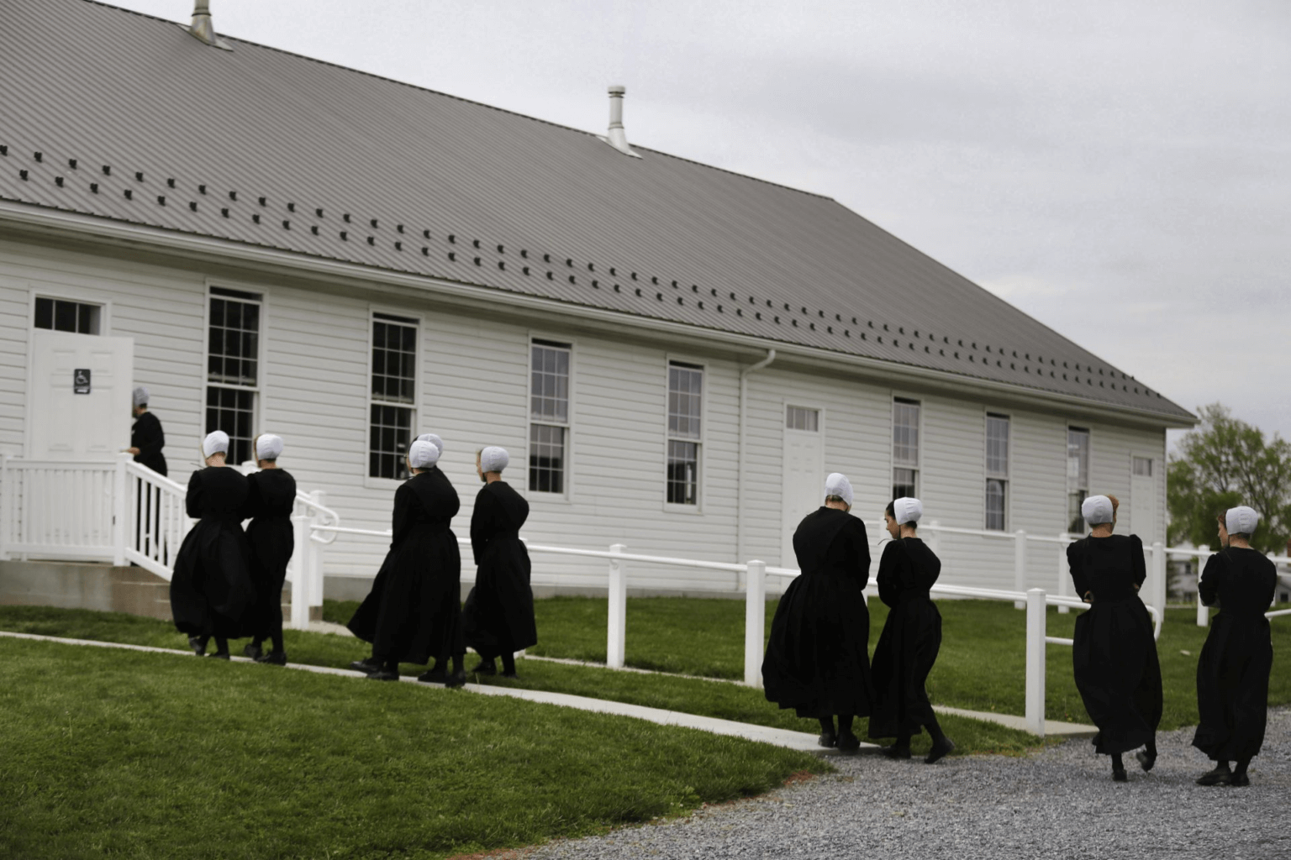

What does the bible say?

Slide 4


God laid a principle 1 Tim 2:8-15
Men lead in prayer (8)
Women profess godliness in dress (9)
Cultural examples, not cultural commands
  11-12 is rooted in 13-15. Creation/Sin.
What’s the instruction?
Input – quietness / Output – not over
Acts 18:26 “they… explained to him…”
Not to teach over a man, not taking the lead and ignoring Genesis.
Notes:
Being in Christ does not require being a member at a local church or part of a local fellowship. They were baptized into Christ.
Then they went on their way and they had to maintain that fellowship with Him.
We learned how you do that from 1 John 1:1-2:1 last week. CLICK

Slide 5
Test Case 1 Cor. 14.1-40
Context: worship assemblies (23,26, 11:20)
3rd use of “CHURCH” = literal assembly.
What’s the instruction? V.26-40
Order must be maintained in the worship assembly (turns & silence/mute)
Rule for tongue speaker (27-28)
Rule for prophet (29-33)
Rule for women (34-35)
A purposed intentional assembly
Our problem with all of it…
Notes:
Being in Christ does not require being a member at a local church or part of a local fellowship. They were baptized into Christ.
Then they went on their way and they had to maintain that fellowship with Him.
We learned how you do that from 1 John 1:1-2:1 last week. CLICK

Slide 6




Institutionalism
Institutional·ism 1. emphasis on organization (as in religion) at the expense of other factors.
Merriam Webster
Mark 7:1-13 – “CORBAN”
“Honor”
Jew
Temple
Mom
Notes:
Being in Christ does not require being a member at a local church or part of a local fellowship. They were baptized into Christ.
Then they went on their way and they had to maintain that fellowship with Him.
We learned how you do that from 1 John 1:1-2:1 last week. CLICK

Slide 7



The “CORBAN” mindset about
collective worship
Ex: “The most important part of our week”
MY
discipleship
Christian
Church
Assemblies
1%
Notes:
Being in Christ does not require being a member at a local church or part of a local fellowship. They were baptized into Christ.
Then they went on their way and they had to maintain that fellowship with Him.
We learned how you do that from 1 John 1:1-2:1 last week. CLICK

Slide 8
Work of Women
Can talk to men John 4:4f, Lk. 10:39
Can be a witness Matt. 18:15-17, 28:7, 1 Cor. 1:11
Must teach all Acts 8:3-4, 2 Tim. 2:2, Lk. 2:36-38, Acts 21:9, 1 Cor. 11:5f
Must work in the gospel Lk. 8:1-3, Phil. 4:3, Rom. 16:1-16
Must teach over women/children Titus 2:3b-5, 2 Tim. 1:5, 3:15
Notes:
Being in Christ does not require being a member at a local church or part of a local fellowship. They were baptized into Christ.
Then they went on their way and they had to maintain that fellowship with Him.
We learned how you do that from 1 John 1:1-2:1 last week. CLICK

Slide 9
Work of Women
Can lead in society Acts 17:4,12, Prov. 31
Must manage the home 1 Tim. 5:14, Titus 2:5
Can contribute to church decisions Acts 6:1-6
Can host a church Col. 4:15
Etc!…. Do we have a biblical view?
Notes:
Being in Christ does not require being a member at a local church or part of a local fellowship. They were baptized into Christ.
Then they went on their way and they had to maintain that fellowship with Him.
We learned how you do that from 1 John 1:1-2:1 last week. CLICK

